Slide 1
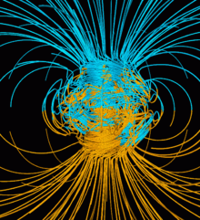
Campo magnético terrestre

Slide 2
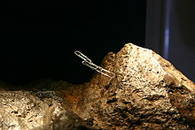
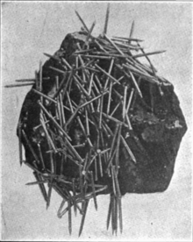

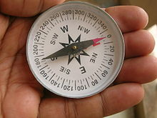
Fenómenos magnéticos
Primer reporte sobre piedra magneto (proveniente de Magnesia, Anatolia). Atracción de hierro y otras piedras magneticas. Tales de Mileto (VI AC)
Aunqu e no lo veamos….
Primer compás magnético
Dinastia Han 206AC
Uso en navegación desde siglo XI
Notes:
The magnetic compass was first invented as a device for divination as early as the Chinese Han Dynasty (since about 206 BC).[1][2][3] The compass was used in Song Dynasty China by the military for navigational orienteering by 1040-1044,[4][5][6] and was used for maritime navigation by 1111 to 1117.[7]

Slide 3
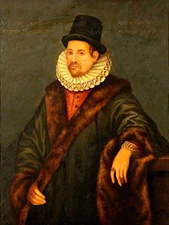
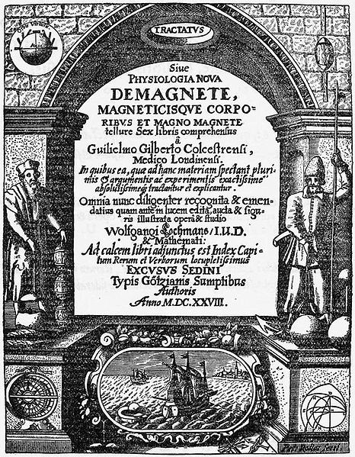
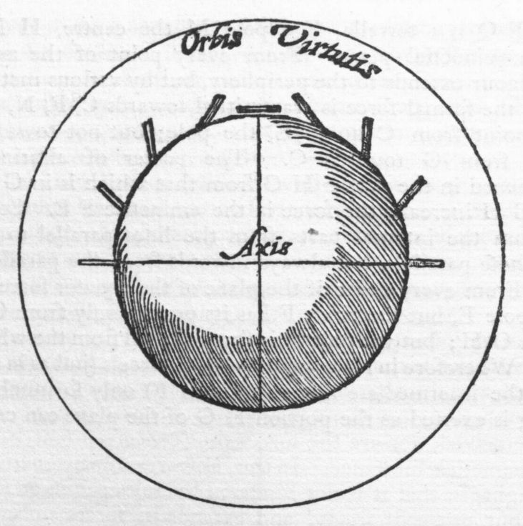
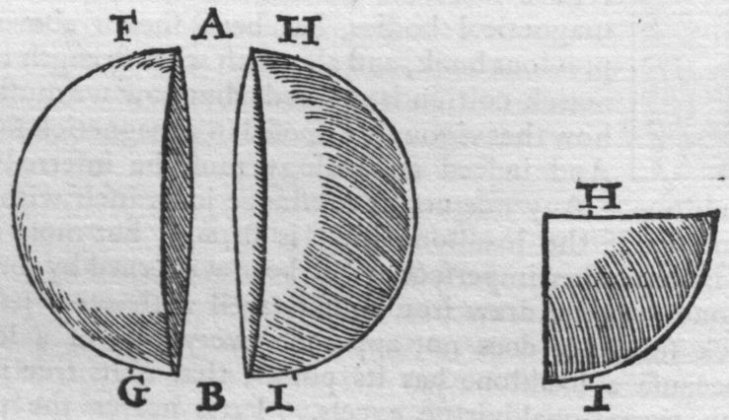
De Magnete
terrella
Primero en proponer que la Tierra actúa como magneto
Explica: agujas de compás magnético apuntan al norte (declinación magnética), y dirección respecto a la superficie (inclinación magnética)
Propone que el centro de la tierra compuesto de hierro
Notó que al cortar un imán se obtienen 2 imanes.
Es el que sugiere el nombre de electricus para describir fenómenos relacionados con frotamiento del ambar.
William Gilbert (1544-1603)
Notes:
In this work, Gilbert described many of his experiments with his model Earth called the terrella. From the experiments, he arrived at the remarkable (and correct) conclusion that the Earth was magnetic and that this was why the compass pointed north. (Previously, it was thought that Polaris or a large magnetic island at the North Pole attracted the compass). Gilbert also made the claim that gravity was due to the same force and he believed that this held the Moon in orbit around the Earth.[2] While incorrect by modern standards, this claim was still far closer to the truth than the ancient Aristotelian theory, which held that the heavenly bodies consist of a special fifth element which naturally moves in circles, while the earthly elements naturally move downward. Johannes Kepler accepted Gilbert's theory and used it as a working basis for his famous laws of planetary motion.
In De Magnete, Gilbert also studied static electricity produced by amber. Amber is called elektron in Greek, and electrum in Latin, so Gilbert decided to refer to the phenomenon by the adjective electricus, giving rise to the modern terms "electric" and "electricity".

Slide 4
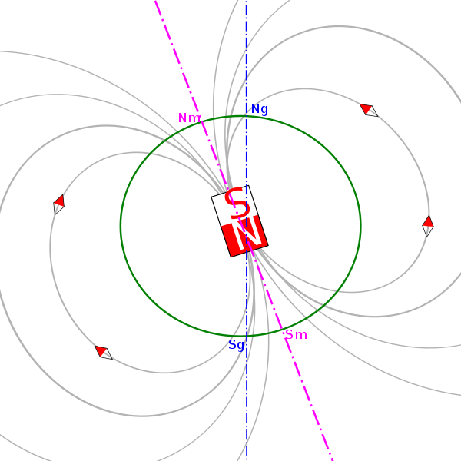
Aproximación dipolar
~10º
Notes:
Ng: norte geografico

Slide 5
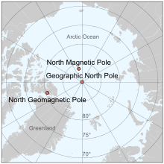
Polos Geomagnéticos
Polos geomagnéticos (Nm, Sm)
puntos donde la dirección asociada al dipolo que mejor aproxima el B terrestre ,intersecan a la superficie
Son antipodales por construcción por lo que presentan igual latitud y longitud complementaria.
~10º
Como el B no es exactamente dipolar:
  El polo Norte Geo-Magnético no coincide con el polo Norte Magnético (ni con el Norte Geográfico)
  las lineas de campo no son completamente verticales en los polos geomagéticos
Notar: Por convencion el Norte geomagnetico y magnetico asociados en realidad al polo sur del dipolo del nucleo terrestre (para que las brujulas apunten al Norte geográfico)
Notes:
Ng: norte geografico

Slide 6
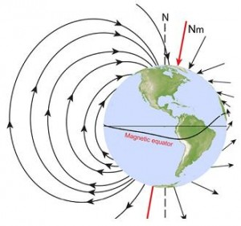
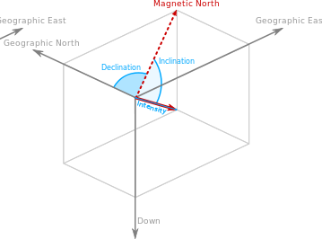
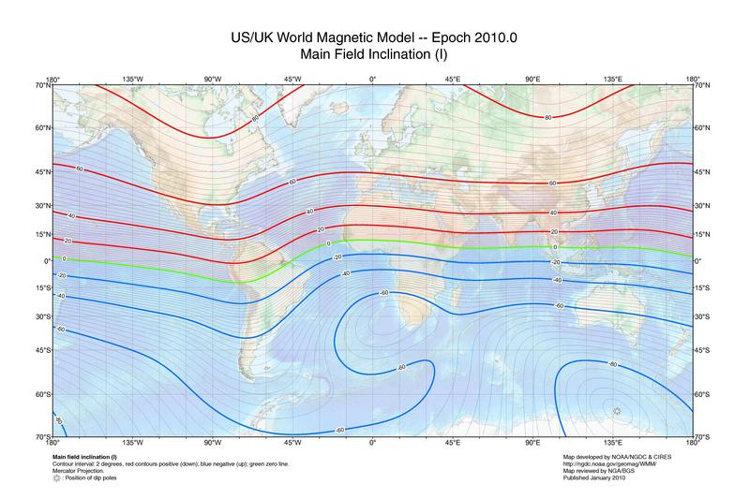
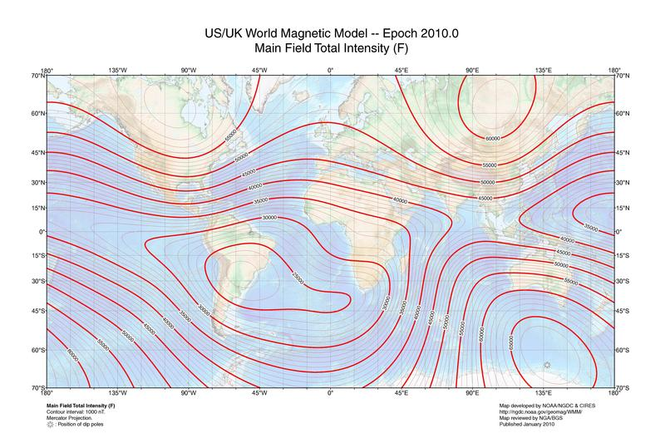
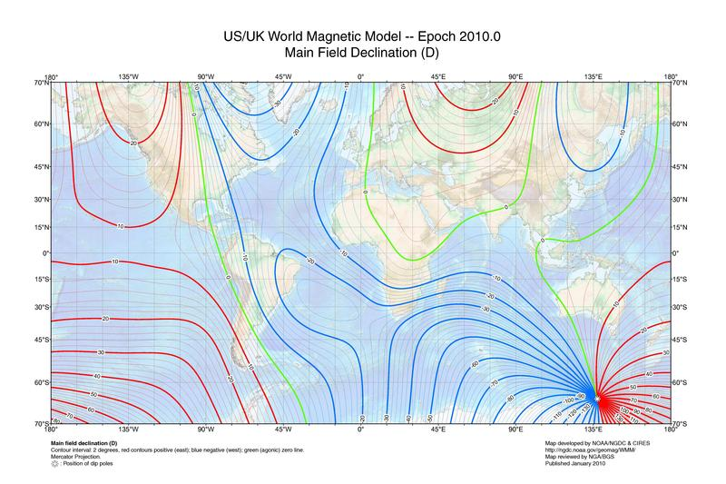
Descripción del B terrestre
Inclinación (líneas isoclínicas):
Desde +90º (down) en Norte a -90º (up) en Sur
Intensidad (líneas isodinámicas) (0.25-0.65 G) decrece desde polos hacia el ecuador
Declinación (líneas isogonicas)
positiva para desviación hacia el este del campo, en relación a la dirección norte
Notes:
Intensity: The intensity of the field is often measured in gauss (G), but is generally reported in nanoteslas (nT), with 1 G = 100,000 nT. A nanotesla is also referred to as a gamma (γ).[13] The tesla is the SI unit of the Magnetic field, B. The Earth's field ranges between approximately 25,000 and 65,000 nT (0.25–0.65 G). By comparison, a strong refrigerator magnet has a field of about 10,000,000 nanoteslas (100 G).[14]A map of intensity contours is called an isodynamic chart. As the World Magnetic Model shows, the intensity tends to decrease from the poles to the equator. A minimum intensity occurs in the South Atlantic Anomaly over South America while there are maxima over northern Canada, Siberia, and the coast of Antarctica south of Australia.[15]
InclinationMain article: Magnetic dipThe inclination is given by an angle that can assume values between -90° (up) to 90° (down). In the northern hemisphere, the field points downwards. It is straight down at the North Magnetic Pole and rotates upwards as the latitude decreases until it is horizontal (0°) at the magnetic equator. It continues to rotate upwards until it is straight up at the South Magnetic Pole. Inclination can be measured with a dip circle.An isoclinic chart (map of inclination contours) for the Earth's magnetic field is shown below.
DeclinationMain article: Magnetic declinationDeclination is positive for an eastward deviation of the field relative to true north. It can be estimated by comparing the magnetic north/south heading on a compass with the direction of a celestial pole. Maps typically include information on the declination as an angle or a small diagram showing the relationship between magnetic north and true north. Information on declination for a region can be represented by a chart with isogonic lines (contour lines with each line representing a fixed declination).

Slide 7
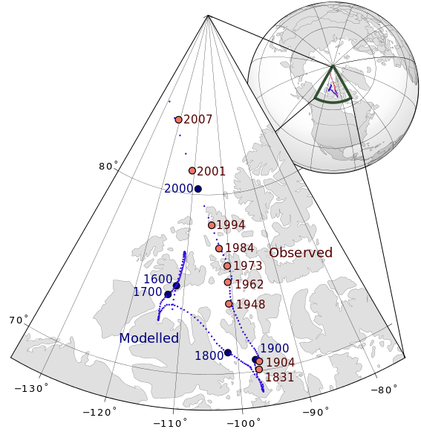
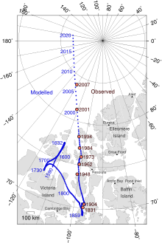
Polos Magnéticos
Los polos magnéticos se mueven, y lo hacen de manera independiente.
El polo norte por ejemplo se está moviendo
por el ártico Canadiense (hasta 40km/año)
Notes:
The two poles wander independently of each other and are not directly opposite each other on the globe. They can migrate rapidly: movements of up to 40 kilometres (25 mi) per year have been observed for the North Magnetic Pole. Over the last 180 years, the North Magnetic Pole has been migrating northwestward, from Cape Adelaide in the Boothia Peninsula in 1831 to 600 kilometres (370 mi) from Resolute Bay in 2001.[19] The magnetic equator is the line where the inclination is zero (the magnetic field is horizontal).

Slide 8
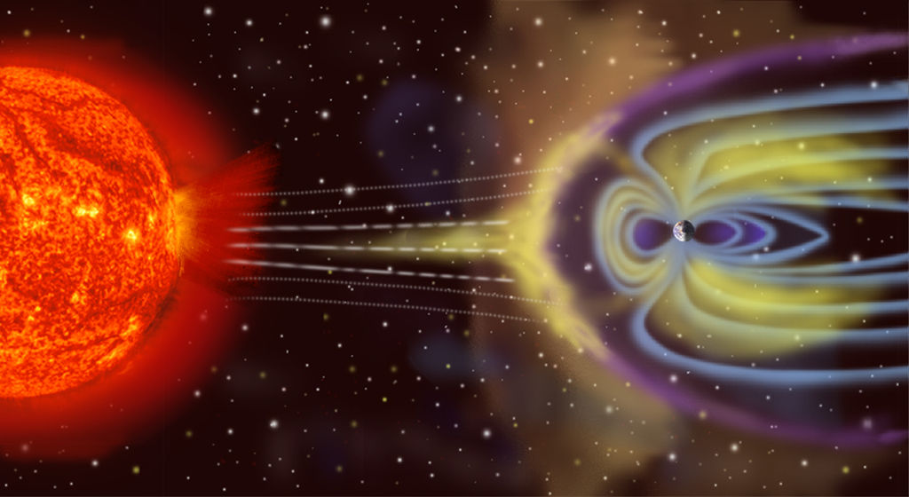
Magnetósfera
El campo B es de tipo dipolar cerca de la superficie….pero en realidad
es alterado por el viento solar : flujo de partículas cargadas emitidas por el sol a muy alta velocidad (200-1000 km/s)
Notes:
A magnetosphere is the area of space near an astronomical object in which charged particles are controlled by that object's magnetic field.[1][2] Near the surface of the object, the magnetic field lines resemble those of a magnetic dipole. Farther away from the surface, the field lines are significantly distorted by electric currents flowing in the plasma (e.g. in ionosphere or solar wind).[3][4] When speaking about Earth, magnetosphere is typically used to refer to the outer layer of the ionosphere,[3] although some sources consider the ionosphere and magnetosphere to be separate.[2]
Earth's magnetic field, predominantly dipolar at its surface, is distorted further out by the solar wind. This is a stream of charged particles leaving the Sun's corona and accelerating to a speed of 200 to 1000 kilometres per second. They carry with them a magnetic field, the interplanetary magnetic field (IMF).[20]

Slide 9
Magnetósfera
Área del espacio, cercana a un objeto astronómico, en la cual partículas cargadas interactúan con el campo magnético del objeto.
Partículas cargadas de alta enería (~200-1000 km/s) son emitidas desde el Sol dando lugar al viento solar, que deforma al campo magnético terrestre.
Proceso involucra: flujos de masa + flujos de carga + fluidos conductores + campos electromagnéticos: magnetohidrodinámica
Notes:
A magnetosphere is the area of space near an astronomical object in which charged particles are controlled by that object's magnetic field.[1][2] Near the surface of the object, the magnetic field lines resemble those of a magnetic dipole. Farther away from the surface, the field lines are significantly distorted by electric currents flowing in the plasma (e.g. in ionosphere or solar wind).[3][4] When speaking about Earth, magnetosphere is typically used to refer to the outer layer of the ionosphere,[3] although some sources consider the ionosphere and magnetosphere to be separate.[2]
Earth's magnetic field, predominantly dipolar at its surface, is distorted further out by the solar wind. This is a stream of charged particles leaving the Sun's corona and accelerating to a speed of 200 to 1000 kilometres per second. They carry with them a magnetic field, the interplanetary magnetic field (IMF).[20]

Slide 10
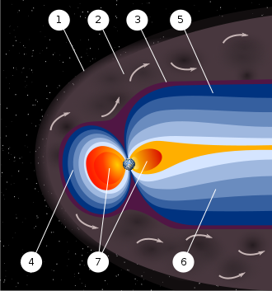
Magnetósfera
Se distinguen varias zonas de acuerdo a las características de la interacción entre viento solar y campo magnético.
(1) Bow shock: zona de frenado del viento.
(3) Magnetopausa: zona donde se igualan presiones, límite de la magnetosfera
(5,6) Magnetotails: zona de sombra muy extendida (~200 R_{T}) opuesta al Sol
(7) Plasmasphere: zona tipo dona desde 60km de altura hasta 3-4 radios terrestres. Esta región rota con la Tierra, incluye a la ionosphere. Los anillos de van Allen se encuentran en esta región
Como resultado de blindaje magnético partículas cargadas (viento solar y rayos cósmicos) no pueden ingresar a la atmósfera y erosionarla
Notes:
The solar wind exerts a pressure, and if it could reach Earth's atmosphere it would erode it. However, it is kept away by the pressure of the Earth's magnetic field. The magnetopause, the area where the pressures balance, is the boundary of the magnetosphere. Despite its name, the magnetosphere is asymmetric, with the sunward side being about 10 Earth radii out but the other side stretching out in a magnetotail that extends beyond 200 Earth radii.[21] Sunward of the magnetopause is the bow shock, the area where the solar wind slows abruptly.[20]
Inside the magnetosphere is the plasmasphere, a donut-shaped region containing low-energy charged particles, or plasma. This region begins at a height of 60 km, extends up to 3 or 4 Earth radii, and includes the ionosphere. This region rotates with the Earth.[21] There are also two concentric tire-shaped regions, called the Van Allen radiation belts, with high-energy ions (energies from 0.1 to 10 million electron volts (MeV)). The inner belt is 1–2 Earth radii out while the outer belt is at 4–7 Earth radii. The plasmasphere and Van Allen belts have partial overlap, with the extent of overlap varying greatly with solar activity.[22]
As well as deflecting the solar wind, the Earth's magnetic field deflects cosmic rays, high-energy charged particles that are mostly from outside the Solar system. (Many cosmic rays are kept out of the Solar system by the Sun's magnetosphere, or heliosphere.[23]) By contrast, astronauts on the Moon risk exposure to radiation. Anyone who had been on the Moon's surface during a particularly violent solar eruption in 2005 would have received a lethal dose.[20]
Some of the charged particles do get into the magnetosphere. These spiral around field lines, bouncing back and forth between the poles several times per second. In addition, positive ions slowly drift westward and negative ions drift eastward, giving rise to a ring current. This current reduces the magnetic field at the Earth's surface.[20] Particles that penetrate the ionosphere and collide with the atoms there give rise to the lights of the aurorae and also emit X-rays.[21]
The varying conditions in the magnetosphere, known as space weather, are largely driven by solar activity. If the solar wind is weak, the magnetosphere expands; while if it is strong, it compresses the magnetosphere and more of it gets in. Periods of particularly intense activity, called geomagnetic storms, can occur when a coronal mass ejection erupts above the Sun and sends a shock wave through the Solar System. Such a wave can take just two days to reach the Earth. Geomagnetic storms can cause a lot of disruption; the "Halloween" storm of 2003 damaged more than a third of NASA's satellites. The largest documented storm occurred in 1859. It induced currents strong enough to short out telegraph lines, and aurorae were reported as far south as Hawaii.[20][24]
A fundamental property of magnetic fields is that they exert forces on moving electrical charges. Thus, a magnetic field can trap charged particles such as electrons and protons as they are forced to execute a spiraling motion back and forth along the field lines.
As illustrated in the adjacent figure, the charged particles are reflected at "mirror points" where the field lines come close together and the spirals tighten. One of the first fruits of early space exploration was the discovery in the late 1950s that the Earth is surrounded by two regions of particularly high concentration of charged particles called the Van Allen radiation belts.
The inner and outer Van Allen belts are illustrated in the top figure. The primary source of these charged particles is the stream of particles emanating from the Sun that we call the solar wind. As we shall see in a subsequent section, the charged particles trapped in the Earth's magnetic field are responsible for the aurora (Northern and Southern Lights).

Slide 11
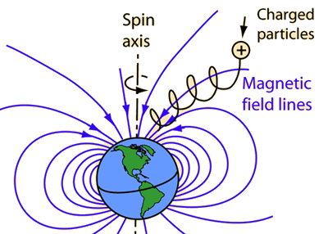
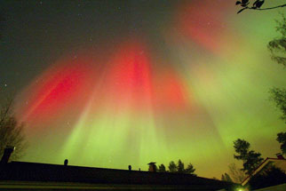
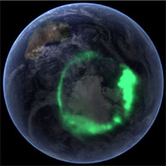
Anilllos de Van Allen
Algunas partículas sí logran atravesar la magnetosfera y se mueven en trayectorias espirales a lo largo de líneas de campo, rebotando varias veces por segundo entre polos.
Las corrientes que se generan pueden hacer disminuir el campo sobre la superficie,
Cuando algunas partículas pueden ingresar a la atmosfera, colisionan con átomos dando lugar a auroras boreales/australes
Notes:
Some of the charged particles do get into the magnetosphere. These spiral around field lines, bouncing back and forth between the poles several times per second. In addition, positive ions slowly drift westward and negative ions drift eastward, giving rise to a ring current. This current reduces the magnetic field at the Earth's surface.[20] Particles that penetrate the ionosphere and collide with the atoms there give rise to the lights of the aurorae and also emit X-rays.[21]
The varying conditions in the magnetosphere, known as space weather, are largely driven by solar activity. If the solar wind is weak, the magnetosphere expands; while if it is strong, it compresses the magnetosphere and more of it gets in. Periods of particularly intense activity, called geomagnetic storms, can occur when a coronal mass ejection erupts above the Sun and sends a shock wave through the Solar System. Such a wave can take just two days to reach the Earth. Geomagnetic storms can cause a lot of disruption; the "Halloween" storm of 2003 damaged more than a third of NASA's satellites. The largest documented storm occurred in 1859. It induced currents strong enough to short out telegraph lines, and aurorae were reported as far south as Hawaii.[20][24]
A fundamental property of magnetic fields is that they exert forces on moving electrical charges. Thus, a magnetic field can trap charged particles such as electrons and protons as they are forced to execute a spiraling motion back and forth along the field lines.
As illustrated in the adjacent figure, the charged particles are reflected at "mirror points" where the field lines come close together and the spirals tighten. One of the first fruits of early space exploration was the discovery in the late 1950s that the Earth is surrounded by two regions of particularly high concentration of charged particles called the Van Allen radiation belts.
The inner and outer Van Allen belts are illustrated in the top figure. The primary source of these charged particles is the stream of particles emanating from the Sun that we call the solar wind. As we shall see in a subsequent section, the charged particles trapped in the Earth's magnetic field are responsible for the aurora (Northern and Southern Lights).

Slide 12
Magnetic Weather
La magnetosfera surge de un proceso dinámico, guiado por la actividad solar
Baja actividad solar, la magnetosfera se extiende.
Mucha actividad solar: tormentas magnéticas, efectos en la Tierra

Slide 13
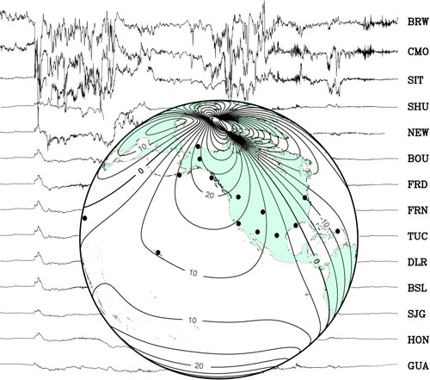
El B terrestre varía en el tiempo
Variaciones rápidas (10⁻³ s - 10⁷s)
Corrientes en la magnetósfera /ionósfera (τ ~ seg)
Tormentas magnéticas (τ ~ hora)
Cambios en el núcleo terrestre (τ <~año)
Registros de tormenta magnética (2000)
Lineas de intensidad de campo magnetico paralelo a la superficie

Slide 14
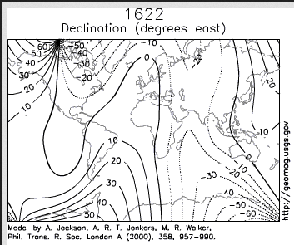
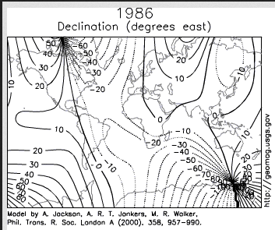
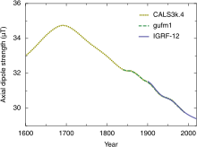
El B terrestre varía en el tiempo
Variaciones seculares ( τ > año)
Cambio continuo de intensidad y orientación del dipolo magnético terrestre, mayormente causado por alteraciones en el sistema dentro del núcleo terrestre que genera el campo planetario.
El campo viene disminuyendo en intensidad un 6-10% los ultimos 200 años
Evidencia geológica de inversión de polaridad!
Notes:
At this rate of decrease, the field would be negligible in about 1600 years.[28] However, this strength is about average for the last 7 thousand years, and the current rate of change is not unusual.[29]

Slide 15
Reversión del campo B
Evidencia geológica de reversión del campo: basaltos, suelos de fondos marinos.
Campos magnéticos ´registrados´ en orden magnético de materiales
Fuerza sobre una espira de corriente (dipolo) ejercida por un B
Notes:
The past magnetic field is recorded mostly by iron oxides, such as magnetite, that have some form of ferrimagnetism or other magnetic ordering that allows the Earth's field to magnetize them. This remanent magnetization, or remanence, can be acquired in more than one way. In lava flows, the direction of the field is "frozen" in small magnetic particles as they cool, giving rise to a thermoremanent magnetization. In sediments, the orientation of magnetic particles acquires a slight bias towards the magnetic field as they are deposited on an ocean floor or lake bottom. This is called detrital remanent magnetization.[7]

Slide 16
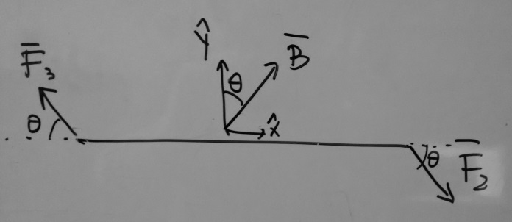
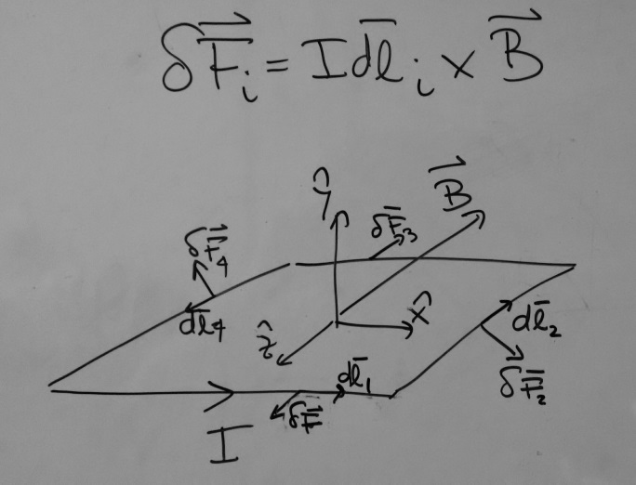
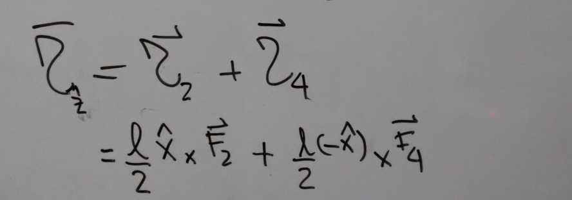
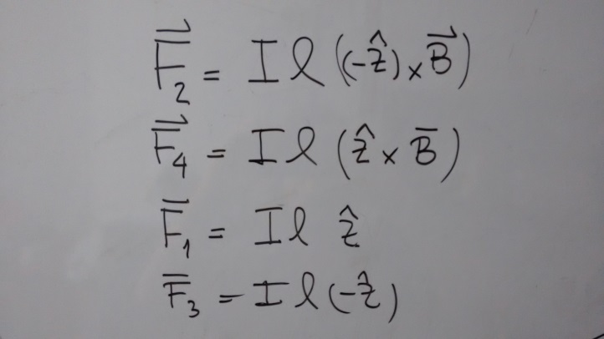
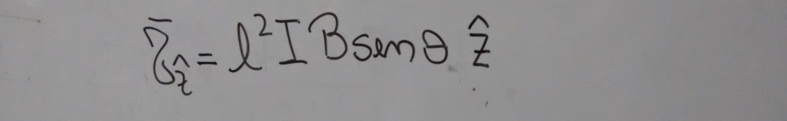
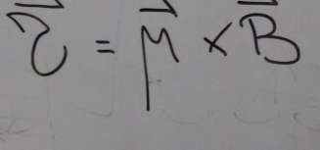

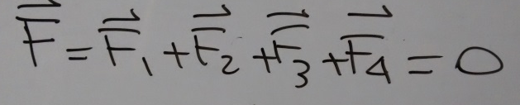
Fuerzas sobre una espira de corriente (dipolo) ejercida por un B
4
Notes:
The past magnetic field is recorded mostly by iron oxides, such as magnetite, that have some form of ferrimagnetism or other magnetic ordering that allows the Earth's field to magnetize them. This remanent magnetization, or remanence, can be acquired in more than one way. In lava flows, the direction of the field is "frozen" in small magnetic particles as they cool, giving rise to a thermoremanent magnetization. In sediments, the orientation of magnetic particles acquires a slight bias towards the magnetic field as they are deposited on an ocean floor or lake bottom. This is called detrital remanent magnetization.[7]

Slide 17
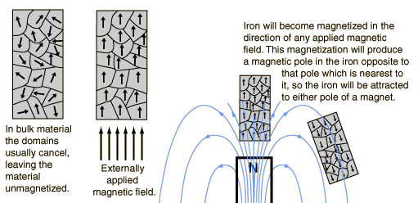
Reversión del campo B
Evidencia geológica de reversión del campo: basaltos, suelos de fondos marinos.
Campos magnéticos ´registrados´ en orden magnético de
  materiales ferromagnético como la magnetita,
  Flujos de lava donde al enfriarse pequeñas partículas magnéticas quedan alineadas al B del momento: magnetización termo-remanente
  Sesgo de alineamiento de partículas magneticas en sedimentos detrital remanent magnetization
Notes:
The past magnetic field is recorded mostly by iron oxides, such as magnetite, that have some form of ferrimagnetism or other magnetic ordering that allows the Earth's field to magnetize them. This remanent magnetization, or remanence, can be acquired in more than one way. In lava flows, the direction of the field is "frozen" in small magnetic particles as they cool, giving rise to a thermoremanent magnetization. In sediments, the orientation of magnetic particles acquires a slight bias towards the magnetic field as they are deposited on an ocean floor or lake bottom. This is called detrital remanent magnetization.[7]

Slide 18
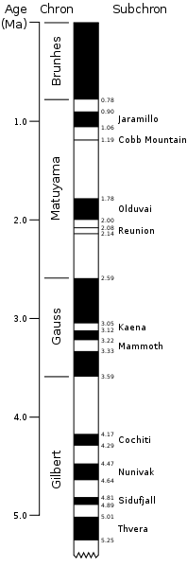
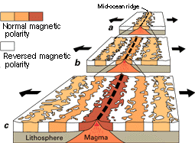
Reversión del campo B
Evidencia geológica de reversión del campo: basaltos, suelos de fondos marinos.
Campos magnéticos ´registrados´ en orden magnético de
  materiales ferromagnético como la magnetita,
  Flujos de lava donde al enfriarse pequeñas partículas magnéticas quedan alineadas al B del momento: magnetización termo-remanente
  Sesgo de alineamiento de partículas magnéticas en sedimentos detrital remanent magnetization
Evidencia fundamental para sostener la teoría de tectónica de placas
Tiras magnéticas
Notes:
The past magnetic field is recorded mostly by iron oxides, such as magnetite, that have some form of ferrimagnetism or other magnetic ordering that allows the Earth's field to magnetize them. This remanent magnetization, or remanence, can be acquired in more than one way. In lava flows, the direction of the field is "frozen" in small magnetic particles as they cool, giving rise to a thermoremanent magnetization. In sediments, the orientation of magnetic particles acquires a slight bias towards the magnetic field as they are deposited on an ocean floor or lake bottom. This is called detrital remanent magnetization.[7]

Slide 19
Reversión del campo B
Evidencia geológica de reversión del campo: basaltos, suelos de fondos marinos.
Campos magnéticos ´registrados´ en orden magnético de sedimentos, materiales ferromagneticos,
Evidencia fundamental para sostener la teoría de tectónica de placas
  Reversiones parecen ocurrir aleatoriamente. La más reciente: Brunhes–Matuyama, occurrió ~780,000 años.
  Se desconoce cuánto dura el período de reversión en sí.
    Steens Mountain, Oregon (6 grados/dia)
    Battle Mountain, Nevada (53grados/año) Lava enfriada, recalentada y vuelta a enfriar (Bogue, Geophysical Research Letters, 2010)
  No hay registros fósiles de eventos ´raros´ ligados a las reversiones. Sabemos poco sobre los posibles efectos concretos de no tener campo (especies ancestrales muy resistentes a mutaciones??)
Notes:
The past magnetic field is recorded mostly by iron oxides, such as magnetite, that have some form of ferrimagnetism or other magnetic ordering that allows the Earth's field to magnetize them. This remanent magnetization, or remanence, can be acquired in more than one way. In lava flows, the direction of the field is "frozen" in small magnetic particles as they cool, giving rise to a thermoremanent magnetization. In sediments, the orientation of magnetic particles acquires a slight bias towards the magnetic field as they are deposited on an ocean floor or lake bottom. This is called detrital remanent magnetization.[7]
The record in one particular lava flow in Nevada suggests the magnetic field moved by 53 degrees in a single year. The lava started to cool, but was then heated again within a year as it was buried under fresh lava. The crystals in the rock were re-magnetized by the fresh lava, producing a shift of 53 degrees. This finding could mean the poles swapped over a period of only four years, but Brogue said it could also suggest there was a rapid acceleration period within the steady movement of the field.
Read more at: http://phys.org/news202971192.html#jCp

Slide 20
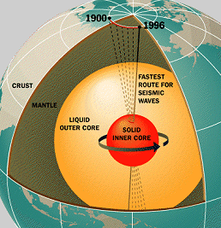
Origen del B terrestre
Ingredientes para generar (y sostener) un campo B
Núcleo interno:
  De hierro sólido
  Muy caliente (5000K)
  Gira a su propio ritmo (0.2º /año más rapido que la sup.)
Núcleo externo:
  mar de hierro líquido (3800K)
  Convección, turbulencia…
Rotación de la Tierra
  Fzas de Coriolis para la dinámica del núcleo externo. Formación de vórticidad, efectos tipo columnas de Taylor.
  Notar que Venus (día de 243 días terrestres) no tiene B
  Notar que Marte (mas frio) tampoco (10⁻⁴ veces el terrestre)
Campo Magnético Interplanetario
Modelo magnetohidrodinámico: el geodínamo

Slide 21
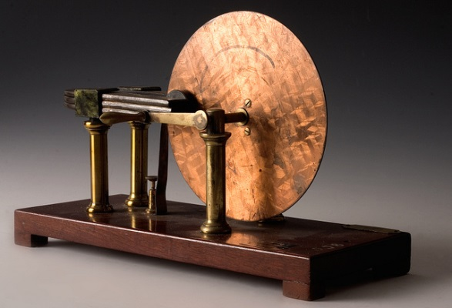
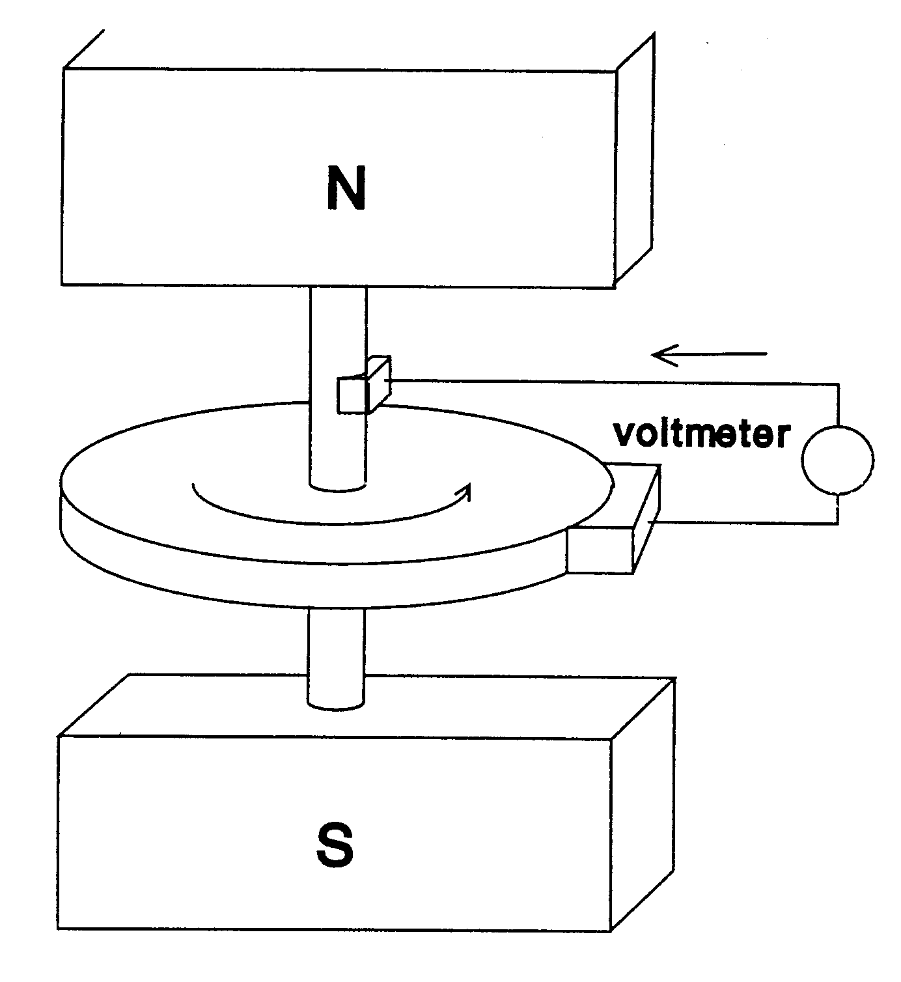
Efecto Dínamo
Disco de Faraday
Generación de corrientes a partir de B y conductor en movimiento
electrón
F
v
B
Dos ingredientes para generar corriente:
conductor en movimiento
campo magnético (fijo y externo)
F = q v x B
Notes:
For some unusual examples of this dynamo process, see the web sites about the dynamo involving Jupiter's moon Io and about the space tether experiment on the Space Shuttle.
Faraday's disk dynamo needs a magnetic field in order to produce an electric current. Is it possible for the current which it generated to also produce the magnetic field which the dynamo process required? That, in a nutshell, was what Larmor proposed was happening in sunspots.
At first sight this looks like a "chicken and egg" propostion: to produce a chicken, you need an egg, but to produce an egg you need a chicken--so which of these came first? Similarly here--to produce a current, you need a magnetic field, but to produce a magnetic field you need a current. Where does one begin? Actually, weak magnetic fields are always present and would be gradually amplified by the process, so this poses no obstacle.
One could, for instance, link two Faraday dynamos, each supplying the current needed to produce the other's magnetic field. They could (in principle) form a feasible self-excited dynamo, deriving its energy from whatever force was turning the disks. However, whether a fluid dynamo could mimic this behavior--e.g. swirls of fluid flow in a tank of liquid mercury--is a much harder question and took decades to resolve.

Slide 22
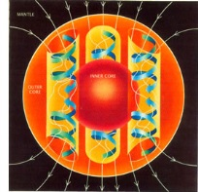
Efecto Dínamo
Disco de Faraday
Generación de corrientes a partir de B y conductor en movimiento
electrón
F
v
B
Podría ser que la corriente generada fuera la que creara el B necesario para seguir generando más corriente?
(el huevo y la gallina)
F = q v x B
Notes:
For some unusual examples of this dynamo process, see the web sites about the dynamo involving Jupiter's moon Io and about the space tether experiment on the Space Shuttle.
Faraday's disk dynamo needs a magnetic field in order to produce an electric current. Is it possible for the current which it generated to also produce the magnetic field which the dynamo process required? That, in a nutshell, was what Larmor proposed was happening in sunspots.
At first sight this looks like a "chicken and egg" propostion: to produce a chicken, you need an egg, but to produce an egg you need a chicken--so which of these came first? Similarly here--to produce a current, you need a magnetic field, but to produce a magnetic field you need a current. Where does one begin? Actually, weak magnetic fields are always present and would be gradually amplified by the process, so this poses no obstacle.
One could, for instance, link two Faraday dynamos, each supplying the current needed to produce the other's magnetic field. They could (in principle) form a feasible self-excited dynamo, deriving its energy from whatever force was turning the disks. However, whether a fluid dynamo could mimic this behavior--e.g. swirls of fluid flow in a tank of liquid mercury--is a much harder question and took decades to resolve.

Slide 23

Geodínamo
Líquido conductor
Movimiento de conductor suficientemente complicado (no rígido ni simétrico)
Campo magnético
Corrientes generan B
B(t) genera E (ley de Faraday)
E y B actuan sobre cargas en movimiento (Fza Lorentz)
Esquema de generación de B por el movimiento de fluido organizado en columnas de Taylor (efecto de Coriolis)
Ecuacion de induccion magnética
u: campo de velocidades del fluido
Notes:
Ecuacion de induccion magnetica

Slide 24
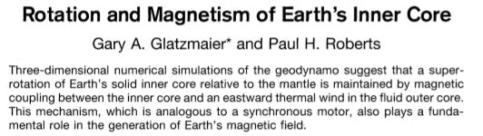
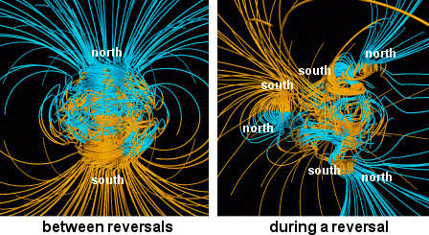
Geodínamo
Science 1996

Slide 25
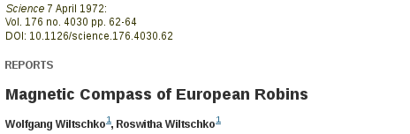

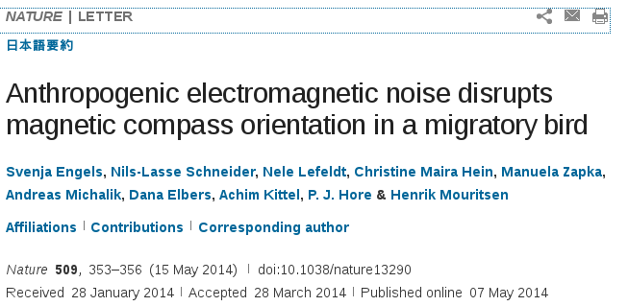
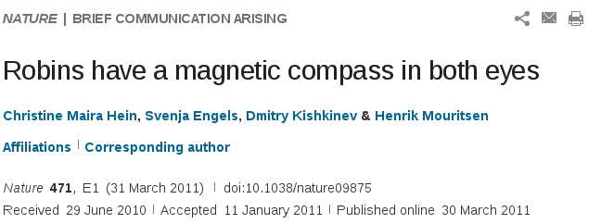
Magnetismo animal
  Existe evidencia de especies animales sensibles al B. Utilización para orientación y navegación.
Petirrojo europeo

Slide 26
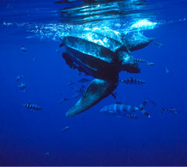
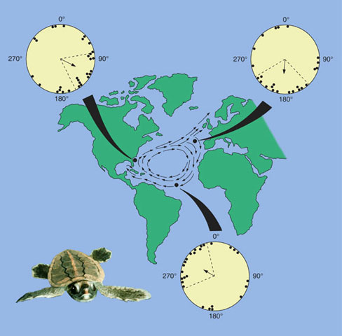
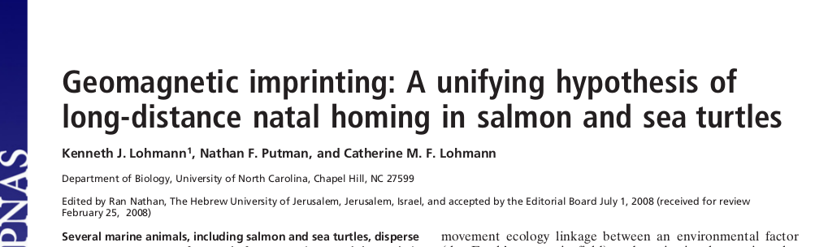

Magnetismo animal
  Existe evidencia de especies animales sensibles al B. Utilización para orientación y navegación.
Notes:
Loggerhead sea turtle hatchlings (Caretta caretta L.) emerge from underground nests, scramble to the sea and begin a transoceanic migration by swimming away from their natal beach and into the open ocean. Evidence suggests that hatchlings sequentially use three different sets of cues to maintain orientation during their initial migration offshore. While on the beach, hatchlings find the ocean by crawling towards the lower, brighter seaward horizon and away from the dark, elevated silhouettes of vegetation and dunes. Upon entering the ocean, turtles initially orient seawards by swimming into waves, which can be detected as orbital movements from under water. Laboratory experiments have demonstrated that turtles can transfer a course initiated on the basis of waves or visual cues to a course mediated by a magnetic compass. Thus, by setting a magnetic course on the basis of nearshore cues that indicate the seaward direction, hatchlings may continue on offshore headings after entering deep water beyond sight of land. Sea turtles may use the earth's magnetic field not only as a cue for compass orientation but also as a source of world-wide positional information. Recent experiments have demonstrated that loggerheads can detect subtle differences in magnetic field inclination and intensity, two geomagnetic features that vary across the surface of the earth. Because most nesting beaches and oceanic regions are marked by a unique combination of these features, these findings raise the possibility that adult sea turtles navigate using a bicoordinate magnetic map.
Loggerhead sea turtle hatchlings (Caretta caretta L.) emerge from underground nests, scramble to the sea and begin a transoceanic migration by swimming away from their natal beach and into the open ocean. Evidence suggests that hatchlings sequentially use three different sets of cues to maintain orientation during their initial migration offshore. While on the beach, hatchlings find the ocean by crawling towards the lower, brighter seaward horizon and away from the dark, elevated silhouettes of vegetation and dunes. Upon entering the ocean, turtles initially orient seawards by swimming into waves, which can be detected as orbital movements from under water. Laboratory experiments have demonstrated that turtles can transfer a course initiated on the basis of waves or visual cues to a course mediated by a magnetic compass. Thus, by setting a magnetic course on the basis of nearshore cues that indicate the seaward direction, hatchlings may continue on offshore headings after entering deep water beyond sight of land. Sea turtles may use the earth's magnetic field not only as a cue for compass orientation but also as a source of world-wide positional information. Recent experiments have demonstrated that loggerheads can detect subtle differences in magnetic field inclination and intensity, two geomagnetic features that vary across the surface of the earth. Because most nesting beaches and oceanic regions are marked by a unique combination of these features, these findings raise the possibility that adult sea turtles navigate using a bicoordinate magnetic map.Several marine animals, including salmon and sea turtles, disperse across vast expanses of ocean before returning as adults to their natal areas to reproduce. How animals accomplish such feats of natal homing has remained an enduring mystery. Salmon are known to use chemical cues to identify their home rivers at the end of spawning migrations. Such cues, however, do not extend far enough into the ocean to guide migratory movements that begin in open-sea locations hundreds or thousands of kilometers away. Similarly, how sea turtles reach their nesting areas from distant sites is unknown. However, both salmon and sea turtles detect the magnetic field of the Earth and use it as a directional cue. In addition, sea turtles derive positional information from two magnetic elements (inclination angle and intensity) that vary predictably across the globe and endow different geographic areas with unique magnetic signatures. Here we propose that salmon and sea turtles imprint on the magnetic field of their natal areas and later use this information to direct natal homing. This novel hypothesis provides the first plausible explanation for how marine animals can navigate to natal areas from distant oceanic locations. The hypothesis appears to be compatible with present and recent rates of field change (secular variation); one implication, however, is that unusually rapid changes in the Earth's field, as occasionally occur during geomagnetic polarity reversals, may affect ecological processes by disrupting natal homing, resulting in widespread colonization events and changes in population structure.

Slide 27

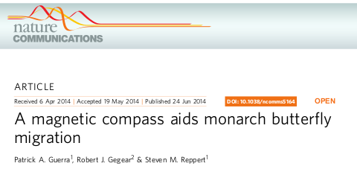
Magnetismo animal
  Existe evidencia de especies animales sensibles al B. Utilización para orientación y navegación.

Slide 28
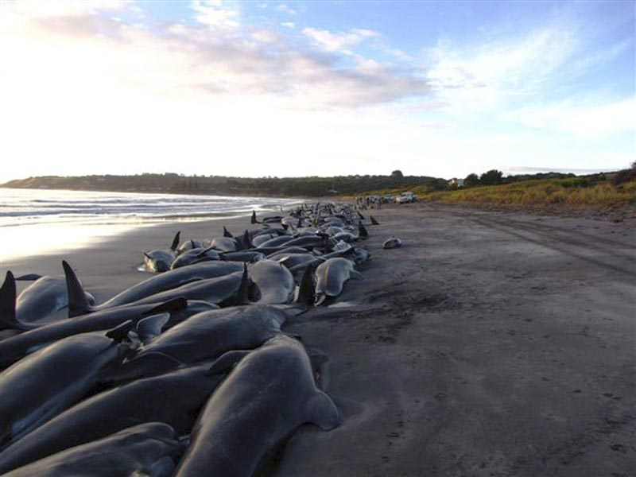
Magnetismo animal
  Existe evidencia de especies animales sensibles al B. Utilización para orientación y navegación.
    Joe Kirschvink (~1990) sugiere que ballenas navegan por ‘canales’ de bajo B que atraviesan el oceano. Encontro que los puntos donde encallan se corresponden con líneas de campo de valores mínimos de B que penetran a la costa. OJO

Slide 29
Terminamos !

